Slide 1
Digital Portfolio
NAME: NOOREA SABA SM REGISTER NO AND NMID:astvu346m24322 DEPARTMENT: BCA COLLEGE :MMES WOMEN'S ARTS AND SCIENCE COLLEGE COLLEGE / UNIVERSITY: COLLEGE

Slide 2
PROJECT TITLE
Our innovative strategies

Slide 3


AGENDA
Problem Statement
Project Overview
End Users
Tools and Technologies
Portfolio design and Layout
Features and Functionality
Results and Screenshots
Conclusion
Github Link
3/21/2024 Annual Review

Slide 4

PROBLEM STATEMENT
Many students and professionals struggle to organize and present their skills , project and achievements effectively traditional resumes are limited and there is a need for digital portfolio that show case talent in modern accessable and professionals way

Slide 5

PROJECT OVERVIEW
✔️a digital portfolio showcase academic and personal achievement 🔷includes the project details , screenshot,& GitHub links act as a bridge between academic work and professionals opportunity ✔️ This is a personal portfolio website that highlights technical skills education, project ,& contact details in user-👍🏻 friendly design

Slide 6

WHO ARE THE END USERS?
=>STUDENTS:- *Project *Academic *Resume =>JOBS SEEKERS:- *To share with recruiters =>FREELANCER:- * To show a client's =>PROFESSIONALS:- *To highlight experience and achievements.

Slide 7

TOOLS AND TECHNIQUES
👉🏻 Frontend :- HTML 'CS ' JAVASCRIPT . 👉🏻 Backend(optionals:- NODE ,JS,PYTHON. Bhi 👉🏻 Database:-mysql,mogodb 👉🏻 Design tools:-canva, Powerpoint,figma.

Slide 8
POTFOLIO DESIGN AND LAYOUT
A portfolio is structured way to showcase your skills, project, achievement,& personality. The design how to look[color'font'visuals] while the layout how content is arranged [ section, navigation,flows] Simple clean and professional designs sections like home, education, skills project,& contact arranged horizontally.
8

Slide 9
FEATURES AND FUNCTIONALITY
👉🏻 Personal information & profile picture 👉🏻 Academic details & certification 👉🏻 Skills & technical expertise 👉🏻 Linked to GitHub to direct LinkedIn.
That means you need to add the URL of your project repository from GitHub. 👉🏻 Example: GitHub Link: https://github.com/username/project-name

Slide 10
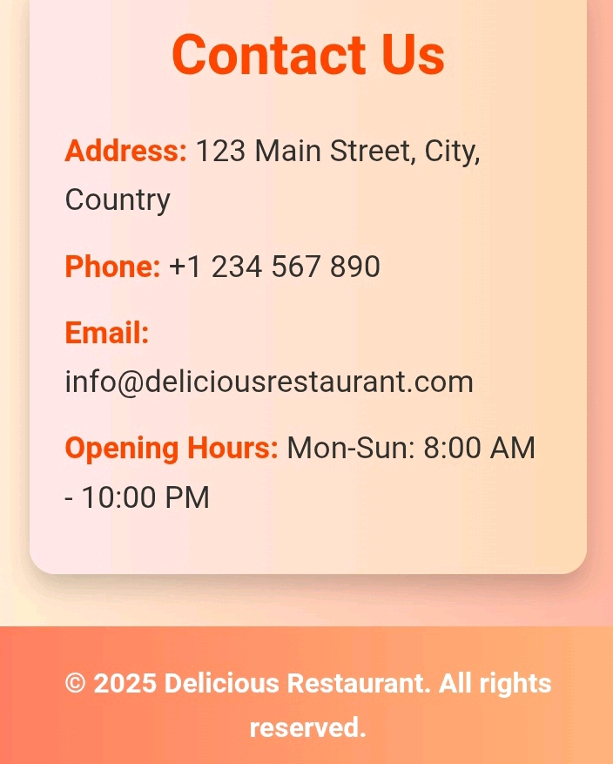
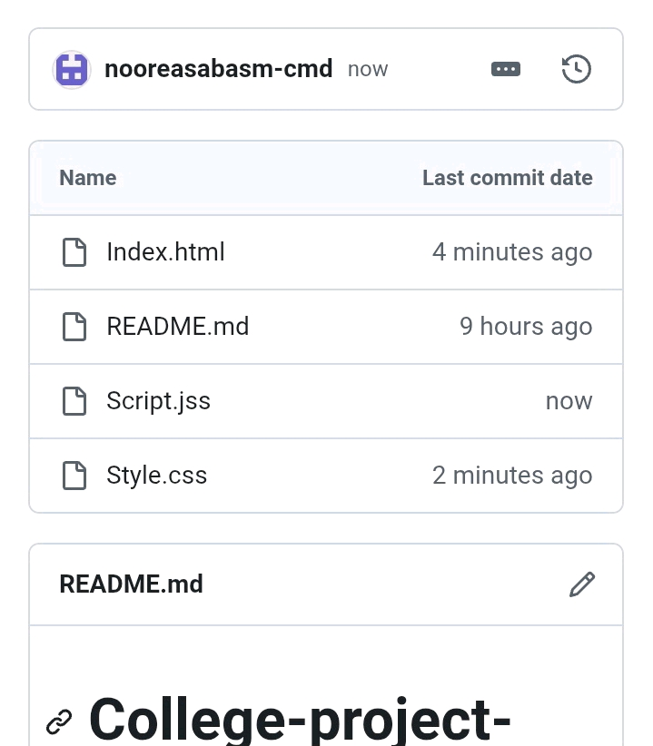

RESULTS AND SCREENSHOTS
3/21/2024 Annual Review
10

Slide 11
CONCLUSION
>>The portfolio highlights academic and personal skills act as professional showcase your skills for future opportunities help in career development and networking >>It helps students and professionals standout going beyond a resume
11

